Slide 1

Homework Assignment #1: Disk IO Performance under Sequential and Random Workloads by Using System Call, C Library and MMAP Interfaces

Slide 2
Outline
File I/O
C-library：fopen()、fread()、fwrite()、fclose()、fseek()
Homework Assignment #1_1
System call：open()、read()、write()、close()、lseek()
Homework Assignment #1_2
Memory-mapped file
Homework Assignment #1_3
Homework Assignment #1_4

Slide 3
File Input / Output
Process A
Read Operation
int main()
{
…
read(fd, buffer, 4096);
…
return 0;
}
User
mode
data
Page Cache
Kernel
mode
HDD
block

Slide 4
File Input / Output
Process A
Write Operation
int main()
{
…
write(fd, data, 4096);
…
close(fd);
return 0;
}
data
User
mode
page cache full
or
call close(fd)
Page Cache
Kernel
mode
HDD

Slide 5
Outline
File I/O
C-library：fopen()、fread()、fwrite()、fclose()、fseek()
Homework Assignment #1_1
System call：open()、read()、write()、close()、lseek()
Homework Assignment #1_2
Memory-mapped file
Homework Assignment #1_3
Homework Assignment #1_4

Slide 6
Standard C library
fopen()
#include <stdio.h>
FILE *fopen ( const char *filename, const char *mode );
EX: FILE *f1;
f1 = fopen ( “XXX.txt”, “w” );
mode:
“r” | read: Open file for input operations. The file must exist.
“w” | write: Create an empty file for output operations. If a file with the same name already exists, its contents are discarded and the file is treated as a new empty file.
“a” | append: Open file for output at the end of a file. Output operations always write data at the end of the file, expanding it. The file is created if it does not exist.
return value: Successful: the function returns a pointer to a FILE object. Otherwise: a null pointer is returned.

Slide 7
Standard C library(cont.)
fread()
#include <stdio.h>
size_t fread ( void * ptr, size_t size, size_t count, FILE * stream );
EX: fread ( buffer, sizeof(char), 4, f1 );
ptr: Pointer to a block of memory with a size of at least (size*count) bytes.
size: Size, in bytes, of each element to be read. size_t is an unsigned integral type.
count: Number of elements, each one with a size of size bytes.
stream: Pointer to a FILE object that specifies an input stream.
return value: The total number of elements successfully read is returned. If this number differs from the count parameter, the proper indicator is set, which can be checked with ferror and feof.

Slide 8
Standard C library(cont.)
fwrite()
#include <stdio.h>
size_t fwrite ( const void * ptr, size_t size, size_t count, FILE * stream );
EX: fwrite ( buffer, sizeof(char), 4, f1 );
ptr: Pointer to the array of elements to be written, converted to a const void*.
size: Size, in bytes, of each element to be written. size_t is an unsigned integral type.
count: Number of elements, each one with a size of size bytes.
stream: Pointer to a FILE object that specifies an output stream.
return value: The total number of elements successfully written is returned. If this number differs from the count parameter, a writing error prevented the function from completing. In this case, the error indicator (ferror) will be set for the stream.

Slide 9
Standard C library(cont.)
fclose()
#include <stdio.h>
int fclose ( FILE * stream );
EX: fclose (f1);
stream: Pointer to a FILE object that specifies the stream to be closed.
return value: If the stream is successfully closed, a zero value is returned. On failure, EOF is returned.

Slide 10
Standard C library(cont.)
fseek()
#include <stdio.h>
int fseek(FILE *stream, long int offset, int whence)
EX: fseek (f1,4096,SEEK_SET);
stream: Pointer to a FILE object that identifies the stream.
long: Number of bytes to offset from origin.
whence: Position used as reference for the offset. It is specified by one of the following constants defined in <cstdio> exclusively to be used as arguments for this function:
Constant | Reference position
SEEK_SET | Beginning of file
SEEK_CUR | Current position of the file pointer
SEEK_END | End of file *
return value: If successful, the function returns zero.
Otherwise, it returns non-zero value.
If a read or write error occurs, the error indicator (ferror) is set.

Slide 11
Outline
File I/O
C-library：fopen()、fread()、fwrite()、fclose()、fseek()
Homework Assignment #1_1
System call：open()、read()、write()、close()、lseek()
Homework Assignment #1_2
Memory-mapped file
Homework Assignment #1_3
Homework Assignment #1_4

Slide 12
Homework Assignment #1_1
Write a program that creates a 200MB file on your local disk and then measures the time to do each of four things by directly using C library I/O interface, e.g., fopen(), fread(), fwrite(), fseek(), and close().
Sequential read： Read the file sequentially by reading the file from beginning to end, and you read 4KB of data at one time.
Sequential write： Overwrite the file with 200MB of new data by writing the file from beginning to end, and you write 2KB of data in one time and then call fsync().
Random read： Do the following 50,000 times: choose a 4KB-aligned offset in the file uniformly at random, seek to that location in the file, and read 4KB of data at that position.
Random write_1：Do the following 50,000 times: choose a 4KB-aligned offset in the file uniformly at random, seek to that location in the file, and write 2KB of data at that position.
Random write_2：Do the following 50,000 times: choose a 4KB-aligned offset in the file uniformly at random, seek to that location in the file, write 2KB of data at that position, and call fsync() after each write.

Slide 13
Homework Assignment #1_1(cont.)
fsync()
fsync() transfers all modified in-core data of the file referred to by the file descriptor fd to the disk device so that all changed information can be retrieved even if the system crashes or is rebooted. This includes writing through or flushing a disk cache if present. The call blocks until the device reports that the transfer has completed.
#include <unistd.h>
int fsync(int fd);
The function fileno() examines the argument stream and returns its integer descriptor.
int fileno(FILE *stream);
Ex：fsync(fileno(fp))

Slide 14
Homework Assignment #1_1(cont.)
gettimeofday()
Get the time as well as a timezone.
#include <sys/time.h>
int gettimeofday (struct timeval *tv, struct timezone *tz );
struct timeval {
time_t tv_sec; /* seconds */
suseconds_t tv_usec; /* microseconds */
};
struct timezone {
int tz_minuteswest; /* minutes west of Greenwich */
int tz_dsttime; /* type of DST correction */
};

Slide 15
Homework Assignment #1_1(cont.)
EX:
int main()
{
struct timeval start;
struct timeval end;
unsigned long diff;
gettimeofday(&start,NULL);
delay(10);
gettimeofday(&end,NULL);
diff = 1000000 * (end.tv_sec-start.tv_sec)+ end.tv_usec-start.tv_usec;
printf("the difference is %ld (us)\n”, diff);
return 0;
}

Slide 16
Homework Assignment #1_1(cont.)
rand()
rand() function is provided by stdlib.h library.
Returns a pseudo-random number in the range of 0 to RAND_MAX.
#include<stdlib.h>
int rand(void);
ex. : rand();

Slide 17
Homework Assignment #1_1(cont.)
srand()
srand() function is provided by stdlib.h library.
This function seeds the random number generator used by the function rand().
#include<stdlib.h>
void srand(unsigned int seed);
ex. : srand(1000);

Slide 18
Homework Assignment #1_1(cont.)
time()
time() function is provided by time.h library.
Calculates the current calender time and encodes it into time_t format.
#include<time.h>
time_t time(time_t *t);
ex. : time(NULL);

Slide 19
Outline
File I/O
C-library：fopen()、fread()、fwrite()、fclose()、fseek()
Homework Assignment #1_1
System call：open()、read()、write()、close()、lseek()
Homework Assignment #1_2
Memory-mapped file
Homework Assignment #1_3
Homework Assignment #1_4

Slide 20
Linux system call interface
open()
#include <sys/types.h>
#include <sys/stat.h>
#include <fcntl.h>
int open ( const char *filename, int flags );
EX: f1 = open ( "hello.txt", O_WRONLY | O_TRUNC );
flags:
O_RDONLY | Read only.
O_WRONLY | Write only.
O_RDWR | Read and write.
O_CREAT | Create file if it doesn’t exist.
O_TRUNC | If the file already exists and the open mode allows writing (i.e., is O_RDWR or O_WRONLY) it will be truncated to length 0.
return value: Return the file descriptor, or -1 is returned and errno is set appropriately.

Slide 21
Linux system call interface(cont.)
read()
#include<unistd.h>
ssize_t read(int fd, void *buf, size_t count);
EX: read(f1, buffer, 4);
fd: The file descriptor of where to read the input.
buf: A character array where the read content will be stored.
count: The number of bytes to read before truncating the data. If the data to be read is smaller than nbytes, all data is saved in the buffer.
return value: Upon successful completion, it shall return a non-negative integer indicating the number of bytes actually read. Otherwise, the functions shall return -1 and set errno to indicate the error.

Slide 22
Linux system call interface(cont.)
write()
#include<unistd.h>
ssize_t write(int fd, const void *buf, size_t count);
EX: write(f1, buffer, 4);
fd: The file descriptor of where to write the input.
buf: A pointer to a buffer of at least nbytes bytes, which will be written to the file.
count: The number of bytes to write. If smaller than the provided buffer, the output is truncated.
return value: On success, the number of bytes written is returned. On error, -1 is returned, and errno is set to indicate the cause of the error.

Slide 23
Linux system call interface(cont.)
close()
#include<unistd.h>
int close(int fd);
EX: close(f1);
fd: The file descriptor to be closed.
return value: returns zero on success. On error, -1 is returned, and errno is set appropriately.

Slide 24
Linux system call interface(cont.)
lseek()
#include <sys/types.h>
#include<unistd.h>
off_t lseek(int fd, off_t offset, int whence);
EX: lseek(f1, 4096, SEEK_SET);
fd: The file descriptor of where to change offset.
offset: Number of bytes to offset from origin.
whence: Position used as a reference for the offset. (you can refer to p10)
return value: Upon successful completion, lseek() returns the resulting offset location as measured in bytes from the beginning of the file. On error, the value (off_t) -1 is returned and errno is set to indicate the error.
Notes:
Use int system call.

Slide 25
Outline
File I/O
C-library：fopen()、fread()、fwrite()、fclose()、fseek()
Homework Assignment #1_1
System call：open()、read()、write()、close()、lseek()
Homework Assignment #1_2
Memory-mapped file
Homework Assignment #1_3
Homework Assignment #1_4

Slide 26
Homework Assignment #1_2
Write a program that creates a 200MB file on your local disk and then measures the time to do each of four things by directly using system call I/O interface, e.g., open(), read(), write(), seek(), and close().
Sequential read： Read the file sequentially by reading the file from beginning to end, and you read 4KB of data at one time.
Sequential write： Overwrite the file with 200MB of new data by writing the file from beginning to end, and you write 2KB of data in one time and then call fsync().
Random read： Do the following 50,000 times: choose a 4KB-aligned offset in the file uniformly at random, seek to that location in the file, and read 3KB of data at that position.
Random buffered write_1：Do the following 50,000 times: choose a 4KB-aligned offset in the file uniformly at random, seek to that location in the file, and write 3KB of data at that position.
Random buffered write_2：Do the following 50,000 times: choose a 4KB-aligned offset in the file uniformly at random, seek to that location in the file, write 3KB of data at that position, and call fsync() after each write.

Slide 27
Outline
File I/O
C-library：fopen()、fread()、fwrite()、fclose()、fseek()
Homework Assignment #1_1
System call：open()、read()、write()、close()、lseek()
Homework Assignment #1_2
Memory-mapped file
Homework Assignment #1_3
Homework Assignment #1_4

Slide 28
Memory-mapped file
Consider a sequential read of a file on disk using the standard system calls open(), read(), and write(). Each file access requires a system call and disk access.
③ copy
user space
user buffer
①
request
kernel space
kernel buffer
read file
②
storage
disk
Read system call

Slide 29
Memory-mapped file(cont.)
We can use the virtual memory techniques to treat file I/O as routine memory accesses. This approach, known as memory mapping a file, allows a part of the virtual address space to be logically associated with the file.
user space
user buffer
①
kernel buffer
kernel space
directly access
②
storage
disk
memory-mapped read

Slide 30
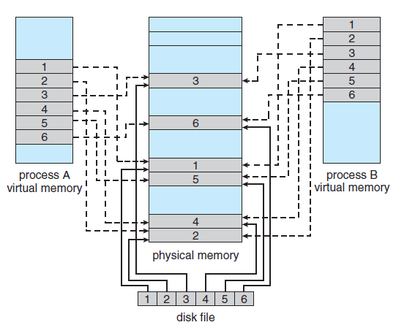
Memory-mapped file(cont.)

Slide 31
Memory-mapped file(cont.)
mmap()
#include <sys/mman.h>
void *mmap(void *addr, size_t length, int prot, int flags, int fd, off_t offset);
EX: char *map_f1;
map_f1 = mmap(NULL, filesize, PROT_READ, MAP_SHARED, f1, 0);
addr、length、fd、offset: The pages starting at addr and continuing for at most length bytes to be mapped from the object described by fd, starting at byte offset offset.
prot:
PROT_EXEC | Pages may be executed.
PROT_READ | Pages may be read.
PROT_WRITE | Pages may be written.
PROT_NONE | Pages may not be accessed.

Slide 32
Memory-mapped file(cont.)
mmap()
flags:
MAP_SHARED | Share this mapping with all other processes that map this object. Storing to the region is equivalent to writing to the file. The file may not actually be updated until msync(2) or munmap(2) are called.
MAP_PRIVATE | Create a private copy-on-write mapping. Stores to the region do not affect the original file. It is unspecified whether changes made to the file after the mmap() call are visible in the mapped region.
return value: On success, mmap() returns a pointer to the mapped area. On error, the value MAP_FAILED (that is, (void *) -1) is returned, and errno is set appropriately.

Slide 33
Memory-mapped file(cont.)
munmap()
#include <sys/mman.h>
int munmap(void *addr, size_t length);
EX: munmap(map_f1, filesize);
addr、length: The function remove any mappings for those entire pages containing any part of the address space of the process starting at addr and continuing for len bytes.
return value: Upon successful completion, it shall return 0; otherwise, it shall return -1 and set errno to indicate the error.

Slide 34
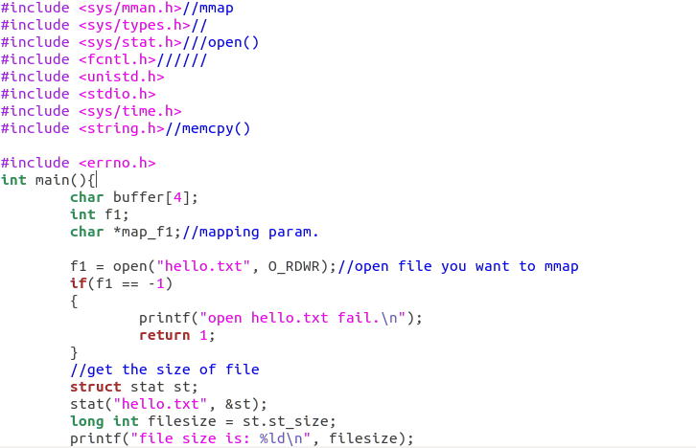
Memory-mapped file(cont.)
Example program

Slide 35
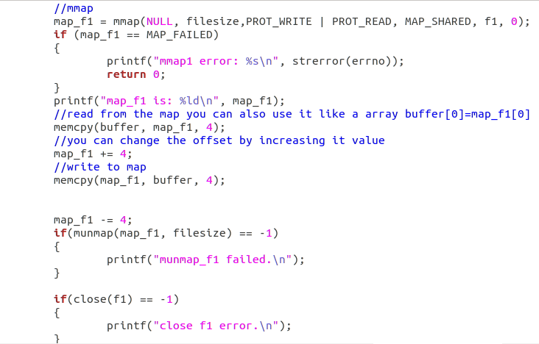

Memory-mapped file(cont.)
Example program

Slide 36
Outline
File I/O
C-library：fopen()、fread()、fwrite()、fclose()、fseek()
Homework Assignment #1_1
System call：open()、read()、write()、close()、lseek()
Homework Assignment #1_2
Memory-mapped file
Homework Assignment #1_3
Homework Assignment #1_4

Slide 37
Homework Assignment #1_3
Write a program that creates a 200MB file on your local disk and then measures the time to do each of four things by directly using memory-mapped I/O interface.
Sequential read：Read the file sequentially by reading the file from beginning to end ,and you read 4KB of data in one time.
Sequential write：Overwrite the file with 200MB of new data by writing the file from beginning to end,and you write 2KB of data in one time and then calling fsync().
Random read：Do the following 50,000 times: choose a 4KB-aligned offset in the file uniformly at random, seek to that location in the file, and read 3KB of data at that position.
Random buffered write_1：Do the following 50,000 times: choose a 4KB-aligned offset in the file uniformly at random, seek to that location in the file, and write 4KB of data at that position. Then, once all 50,000 writes have been issued.
Random buffered write_2：Do the following 50,000 times: choose a 4KB-aligned offset in the file uniformly at random, seek to that location in the file, write 3KB of data at that position, and call fsync() after each individual write.

Slide 38
Outline
File I/O
C-library：fopen()、fread()、fwrite()、fclose()、fseek()
Homework Assignment #1_1
System call：open()、read()、write()、close()、lseek()
Homework Assignment #1_2
Memory-mapped file
Homework Assignment #1_3
Homework Assignment #1_4

Slide 39
Homework Assignment #1_4
Compare the times measured in Homework 1_1, 1_2, and 1_3 and explain the results.
Notably,
Clear the page cache after running your program each time.

Slide 40
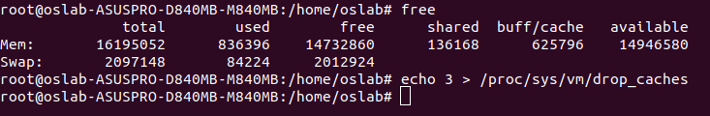
Clean page cache
If you want to take a look at the total available as well as used memory in the system. You can use free command.
To clean the Linux buffer/cache, you can use echo 3 > /proc/sys/vm/drop_caches command. Notice that, you should run it in root mode.
Ex:

Slide 41
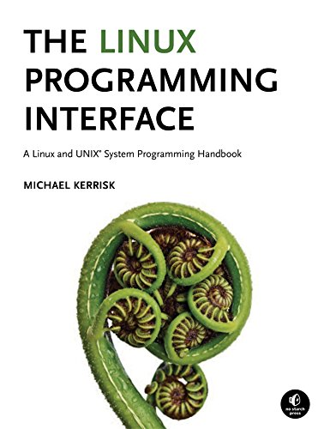
Reference
The Linux Programming Interface: A Linux and UNIX System Programming Handbook.

Slide 42
Turn in
Deadline
2022/4/8 23:59:59
Upload to i-learning 3.0
File name
HW1_ID.zip (e.g. HW1_7105056035.zip)
Source code
HW1_1.c、HW1_2.c、HW1_3.c
Word file(HW1_4)
If you don’t hand in your homework on time, your score will be deducted 10 points every day.

Slide 43
TA
Name: 黃聖穎
Email: andrew841018@gmail.com
Lab: OSNET(1001A)

